Slide 1






Lecture 31:
Forms in React & Form Validation
Course - Web Development - II
-By
Instructor Name
welcome@krmangalam.edu.in
Sohna Road,Gurugram,Haryana 122103

Slide 2

| Table of Contents
Controlled vs. Uncontrolled Components.
Handling Forms in React.
Handling Input Fields.
Form Validation & Submission.
Event Handling in JSX
Synthetic Events in React
References.
The End.

Slide 3

|
Would you prefer to control every detail of a party yourself, or delegate everything to a friend and trust them to manage it?

Slide 4
|
Would you prefer to control every detail of a party yourself, or delegate everything to a friend and trust them to manage it?
If you want full control and exact results, you manage everything yourself (like a controlled component).
If you prefer less effort and trust others to handle it, you delegate (like an uncontrolled component). Which is easier depends on your choice between control and convenience.
Controlled components as the party planner who is actively managing and controlling the inputs and state.
Uncontrolled components as the friend who plans independently, with minimal real-time control from you.

Slide 5
| Controlled Components
A controlled component is a form element (like <input>, <textarea>, or <select>) whose value is controlled by React state rather than the DOM itself.
How it works
The form field’s value is stored in state.
You update that state via an onChange handler.
The field’s displayed value always comes from the state.

Slide 6
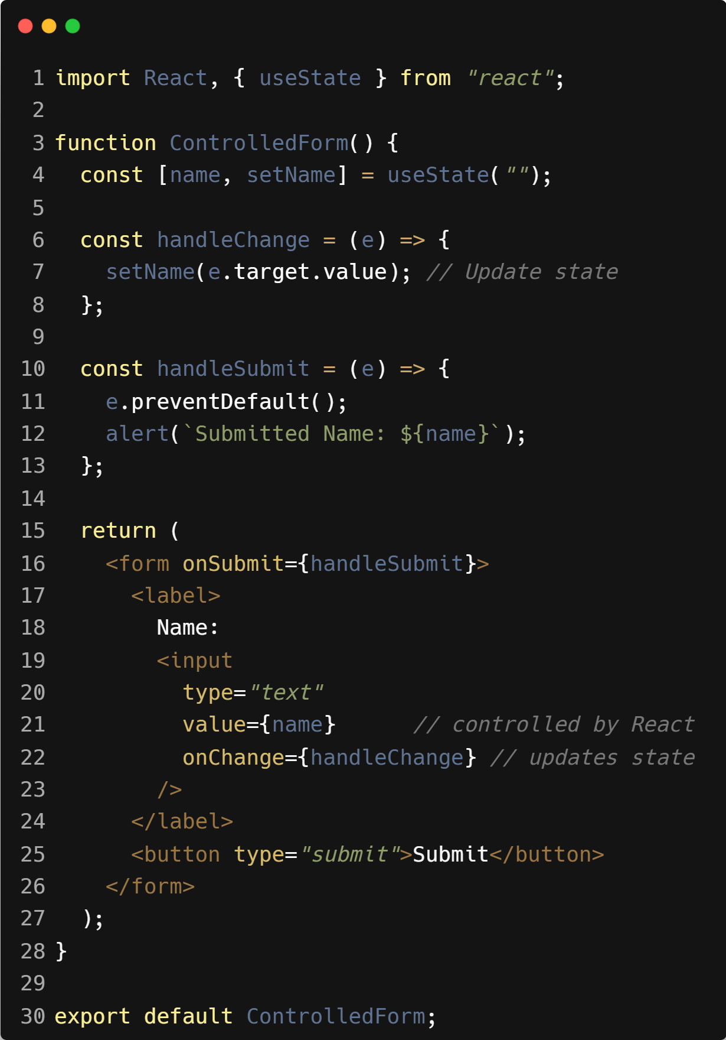
| Example : Controlled Components

Slide 7
| Controlled Components
Key Points
Value comes from state, not from the DOM directly.
Every keystroke triggers onChange, which updates state.
The UI is always in sync with your state.
Why use controlled components?
Single source of truth (state).
Easy to validate and format inputs.
Makes complex form logic easier (e.g., disabling buttons, live previews).

Slide 8
| Uncontrolled Components
An uncontrolled component is a form element that manages its own state internally in the DOM, instead of being controlled by React state.
Instead of binding the value to state and updating on every change, you let the browser handle the value and only read it when needed—usually with a ref.
How it works
No value prop bound to state.
You use defaultValue (for initial value) or nothing at all.
To get the value, you access the DOM element directly via a ref.

Slide 9
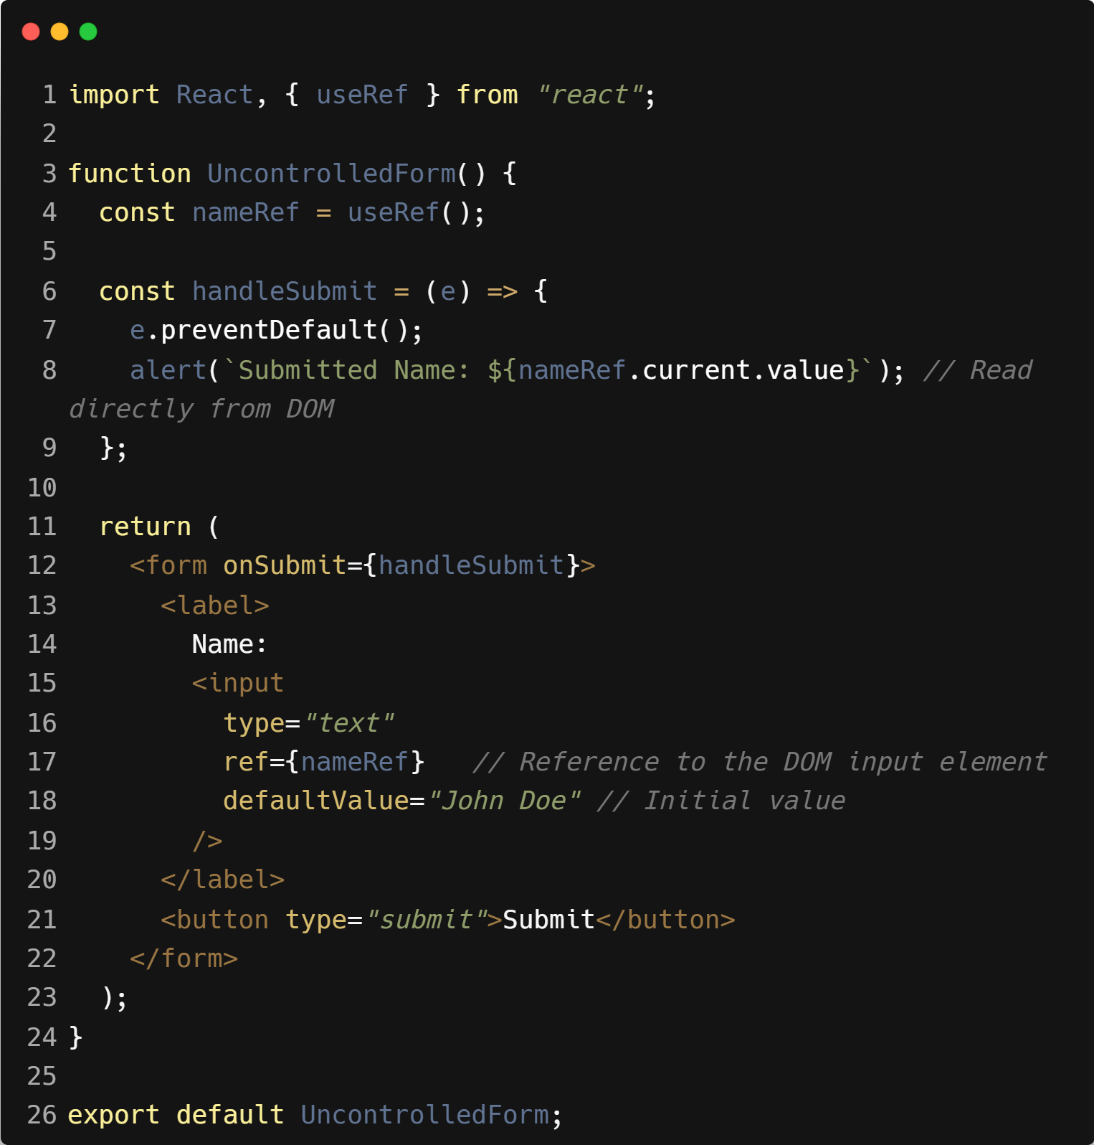
| Uncontrolled Components

Slide 10
| Uncontrolled Components
Key Points
DOM is the source of truth for the value, not React state.
You usually read the value only when needed (e.g., form submit).
You use ref to access the element and its value.
defaultValue sets the initial value (like HTML’s value attribute).
Why use uncontrolled components?
Less code for simple forms.
No re-render on every keystroke.
Good for integrating with non-React code or libraries

Slide 11
| Uncontrolled Components
Feature | Controlled Component | Uncontrolled Component
State management | Value is stored in React state | Value is stored in the DOM
Source of truth | React state | DOM element
How to access value | From the state variable | Using a ref (elementRef.current.value)
Value prop | Must pass value and onChange | Uses defaultValue (or no prop)
Rendering on change | Re-renders on every keystroke | Doesn’t re-render on typing

Slide 12

|
Would you want a job application form to save and update your answers instantly, or let you fill it out freely and review only at the end?

Slide 13

|
Would you want a job application form to save and update your answers instantly, or let you fill it out freely and review only at the end?
Some prefer forms that update answers instantly for safety and feedback (like controlled components), while others prefer filling freely and reviewing later for simplicity (like uncontrolled components).
It depends on whether you want control or ease.

Slide 14
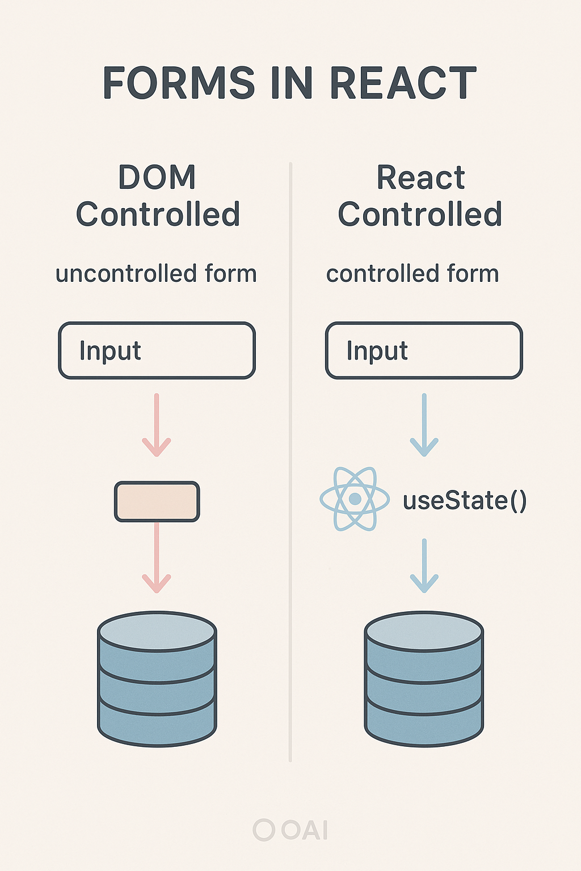
| Handling Forms in React
Forms in React are used to collect and manage user input, but unlike plain HTML, React encourages us to decide who controls the form data — React (controlled) or the DOM (uncontrolled).

Slide 15
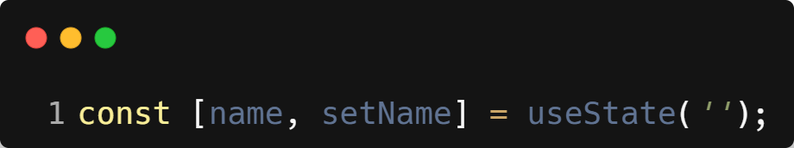
| The Three Steps of a Controlled Input : Handling Forms
1. Create State to Hold the Value
Use the useState hook to create a state variable that will store the input’s current value.
Here,
name → stores the current value of the input.
setName → updates the value of name.

Slide 16
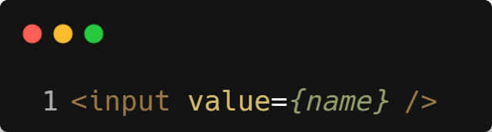
| The Three Steps of a Controlled Input : Handling Forms
2. Bind the Input’s value to State
Link the state variable to the input’s value attribute so that the input always displays the latest state.
Now, whenever the state changes, the input’s displayed value updates automatically.

Slide 17
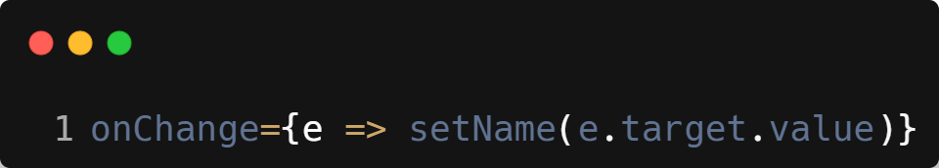
| The Three Steps of a Controlled Input : Handling Forms
3. Handle Changes with onChange
Add an onChange event handler to capture user input. The event object e contains the latest typed value in e.target.value. Use the state setter function to update the state.
This ensures that each keystroke updates the state, and the state updates the input’s displayed value.

Slide 18

| Would you board a plane without the staff checking your
ticket and passport first?

Slide 19

| Would you board a plane without the staff checking your
ticket and passport first?
No → Because checks are important for safety and correctness.
It naturally leads to the analogy:
Ticket & passport check = Form
Validation
Boarding the plane = Form
Submission

Slide 20
| Form Validation
Form validation is the process of checking if the data entered by the user into a form is correct, complete, and in the right format before submitting it.
Why Form Validation is Important
Prevents incorrect or incomplete data from being processed.
Improves user experience by guiding users to fix mistakes.
Protects against security issues like malicious input.
Saves time and effort by catching errors early.

Slide 21
| Types Of Form Validation
Client-Side Validation
Happens in the browser before sending data to the server.
Quick feedback to the user.
Examples: Checking empty fields, email format, password length.
Server-Side Validation
Happens after form data is sent to the backend.
More secure because it can’t be bypassed.
Examples: Checking if username already exists, verifying OTP.

Slide 22
| Common Validation Rules
Required field check → Field cannot be empty.
Pattern matching → Email format, phone number format.
Length constraints → Password must be at least 8 characters.
Value range → Age must be between 18 and 60.

Slide 23
| Form Submission
Form submission is the process of sending the validated form data to a server or another part of your application for further processing.
How Form Submission Works
User fills out the form → Enters data into form fields.
Validation occurs → Checks if the data is correct and complete.
Submit event triggers → Usually by clicking a button with type="submit" or pressing Enter.
Data is processed:
Sent to a server via an API call (e.g., fetch, axios).
Or handled locally (e.g., updating a list in state).

Slide 24
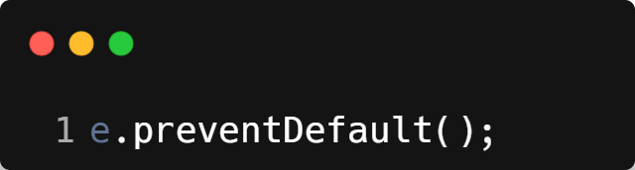
| React Form Submission Steps
1. Prevent Default Browser Behavior
HTML forms reload the page on submit by default.
In React, use:
to stop the reload.

Slide 25
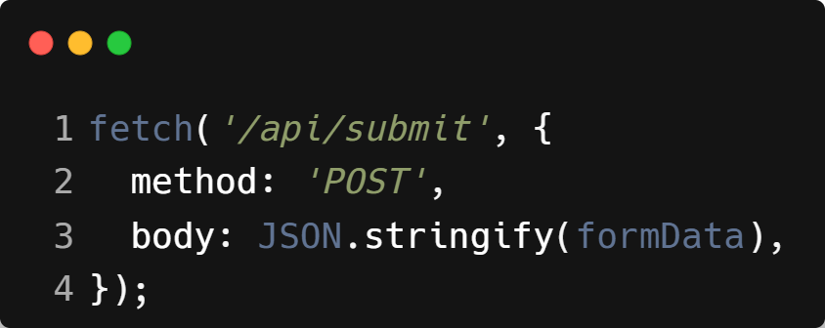
| React Form Submission Steps
2. Collect Form Data
Use state variables (controlled components) to store input values.
Or use refs (uncontrolled components) to read values.
3. Send Data to Server or Process Locally

Slide 26
| React Form Submission Steps
4. Provide Feedback to User
Success → Show confirmation or redirect.
Failure → Show error message.

Slide 27
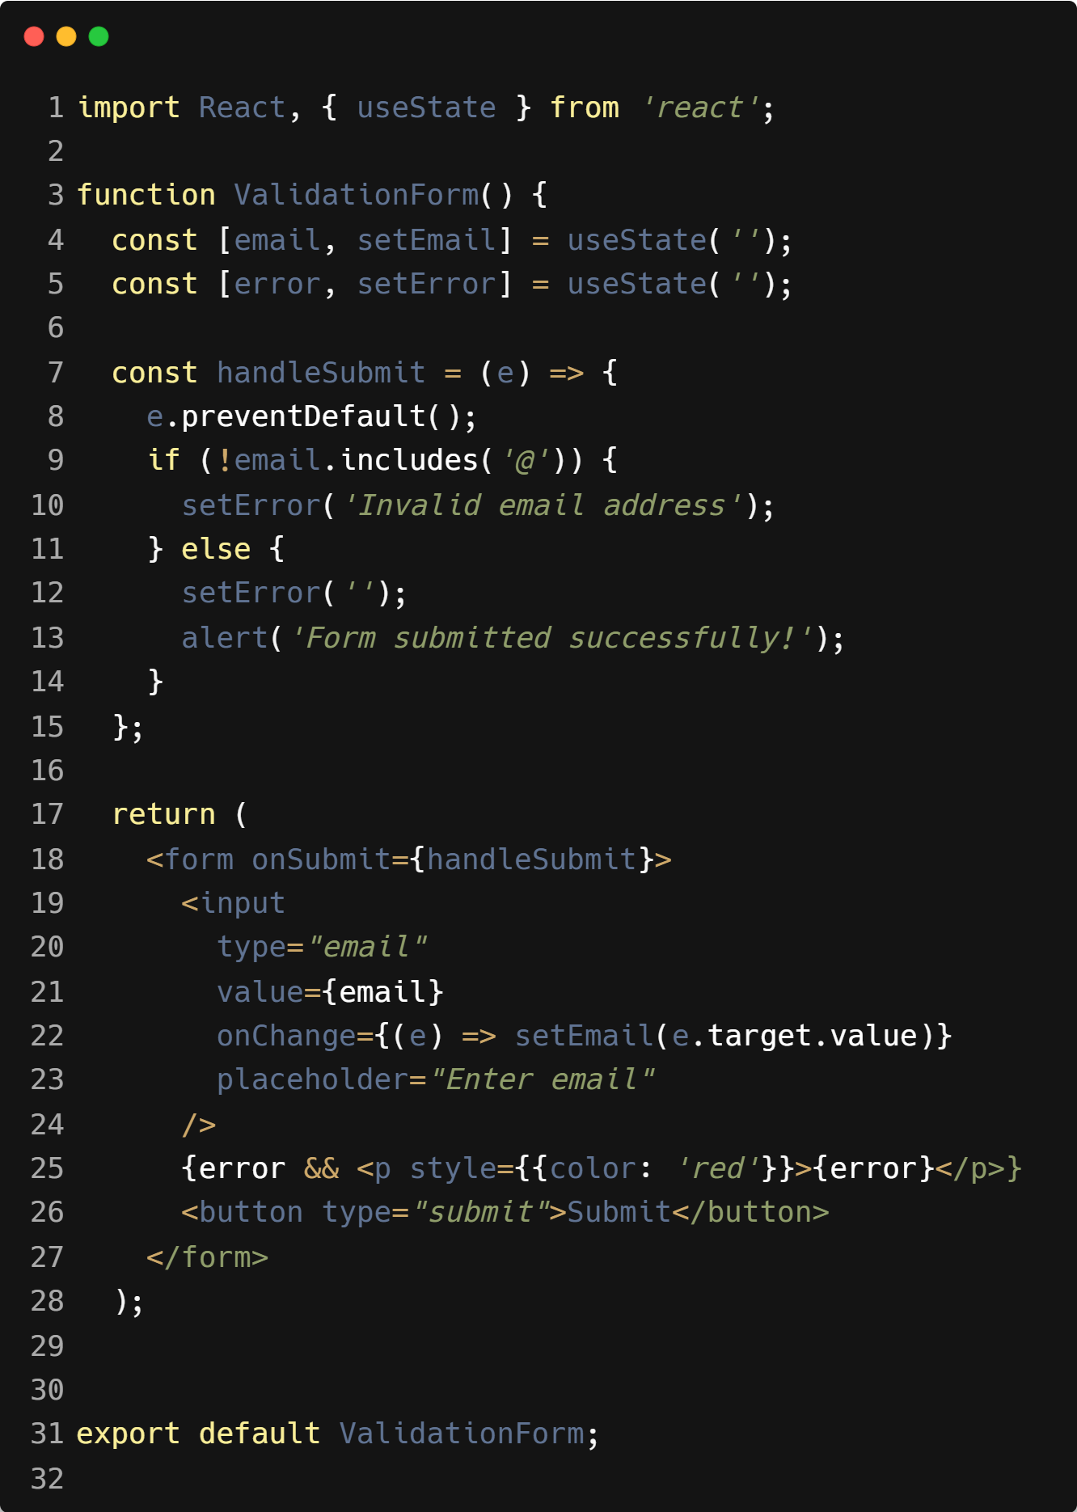
| Example : Form Validation & Submission

Slide 28

| When you’re watching TV, do you get up every time you
want to change the channel, or do you use a remote?

Slide 29
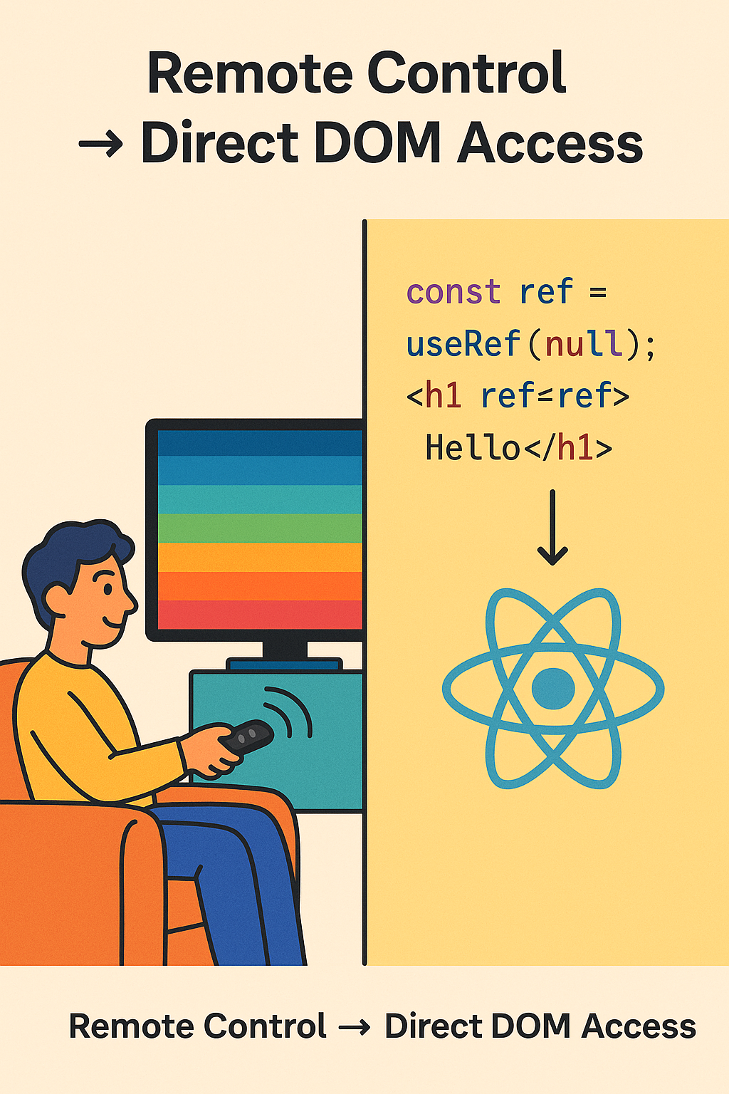
| When you’re watching TV, do you get up every time you
want to change the channel, or do you use a remote?
In React, useRef works like that remote control — it lets you directly interact with the DOM element without ‘walking through’ the whole re-render process.

Slide 30

|
In plain HTML, how do we normally attach a click event to a button?

Slide 31

|
In plain HTML, how do we normally attach a click event to a button?
HTML uses inline attributes:
Problem: This mixes JS inside HTML strings.
Transition: “React fixes this with a cleaner, more consistent syntax.”

Slide 32
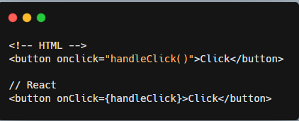
| Syntax Difference : CamelCase
HTML → onclick="handleClick()" (string).(lowercase).
React → onClick={handleClick} (function reference). (camelCase).

Slide 33
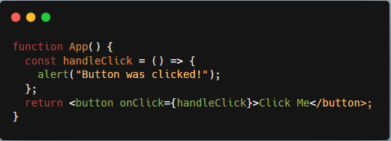
| Defining and Passing a Handler
✅ Correct → onClick={handleClick} Runs on click.
❌ Wrong → onClick={handleClick()} executes immediately.

Slide 34

| Inline Arrow Functions
Creates new function each render.
Fine for simple cases.

Slide 35
| Common React Events
Mouse Events: onClick, onDoubleClick, onMouseEnter, onMouseLeave
Keyboard Events: onKeyDown, onKeyUp
Form Events: onChange, onSubmit, onFocus, onBlur
Many more available in docs.

Slide 36
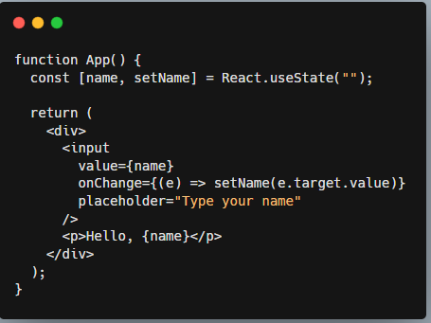
| Example: Input Handling with onChange

Slide 37
| JSX vs HTML Comparison
Feature | HTML Example | React Example
Case | onclick="..." | onClick={...}
Value type | String of code | Function reference
Execution time | Runs immediately | Runs only when clicked

Slide 38
|
Why do you think React doesn’t just use the browser’s default event object directly?

Slide 39

|
Why do you think React doesn’t just use the browser’s default event object directly?
Every browser has slightly different event implementations.
Example: Some browsers use event.srcElement, others use event.target.
This causes inconsistencies for developers.

Slide 40
| The Solution: SyntheticEvent
React wraps native events in a SyntheticEvent.
It:
Normalizes event properties across browsers.
Ensures consistent behavior in all environments
Universal Power Adapter Analogy
Different countries → Different power sockets (browsers).
Universal adapter → Fits all sockets.
SyntheticEvent is like that adapter → one API that works everywhere.

Slide 41
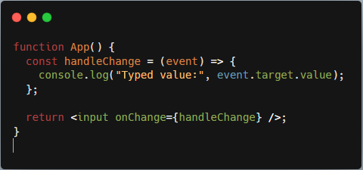
| Example: Handling Synthetic Events
👉 The event here is SyntheticEvent, not the native one.

Slide 42
| Properties of SyntheticEvent
Has the same interface as native events.
Commonly used:
event.target → element that triggered the event
event.preventDefault() → stop default behavior
event.stopPropagation() → stop bubbling

Slide 43
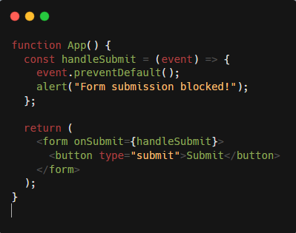
| preventDefault Example
You click the Submit button.
The browser tries to submit the form.
React calls handleSubmit.
preventDefault() stops the page refresh.
An alert pops up: “Form submission blocked!”.
Works consistently in all browsers.

Slide 44
| Quick Comparison
Feature | Native Event (Browser) | SyntheticEvent (React)
Browser consistency | ❌ Different APIs | ✅ Standardized API
Methods available | Vary | preventDefault(), stopPropagation() (same everywhere)
Performance | Normal | Event pooling (optimized)
❌ Thinking it’s the native browser event.
✔ It’s a wrapper that behaves like native, but is cross-browser safe.

Slide 45

| Imagine you have 5 buttons, each saying ‘Delete’. How do you know which item to delete when a button is clicked?

Slide 46
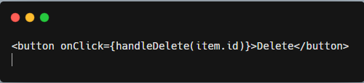
| Imagine you have 5 buttons, each saying ‘Delete’. How do you know which item to delete when a button is clicked?
Event handlers often need extra information (like item ID, name, index).
But passing arguments incorrectly can cause problems.
Example mistake:
❌ This will run immediately when the component renders, not when clicked.
In React, onClick={...} expects a function reference.
Writing handleDelete(item.id) actually calls the function immediately.
So React doesn’t wait for the click — it just executes.

Slide 47
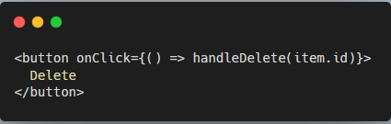
| Imagine you have 5 buttons, each saying ‘Delete’. How do you know which item to delete when a button is clicked?
The Solution : ✔ Use an inline arrow function:
Now React has a function to call later (when the click happens).
The arrow function “remembers” the item.id argument.

Slide 48
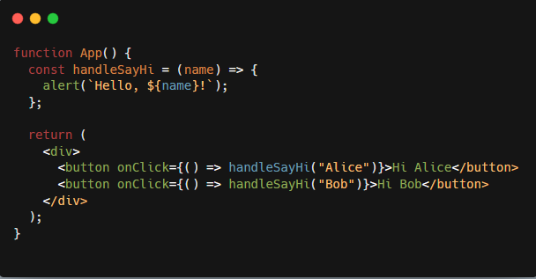
| Small Example
✅ Each button passes a different argument.

Slide 49
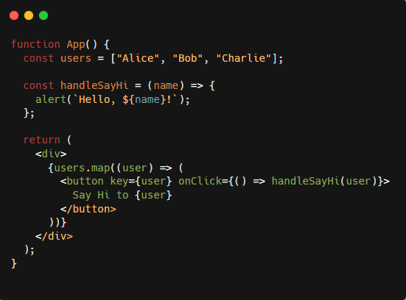
| Real Use Case: Lists
✅ Each button passes the correct user name.

Slide 50
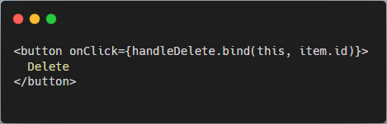
| Alternative Syntax
.bind() creates a new function with item.id fixed as the first argument.
Less common in functional components, but worth mentioning.

Slide 51

| Coding Questions
1. Simple Controlled Input
Task :
Create a component that contains a single text input. Make it a controlled component by using useState to manage its value. Display the current value of the input in a paragraph below it.

Slide 52
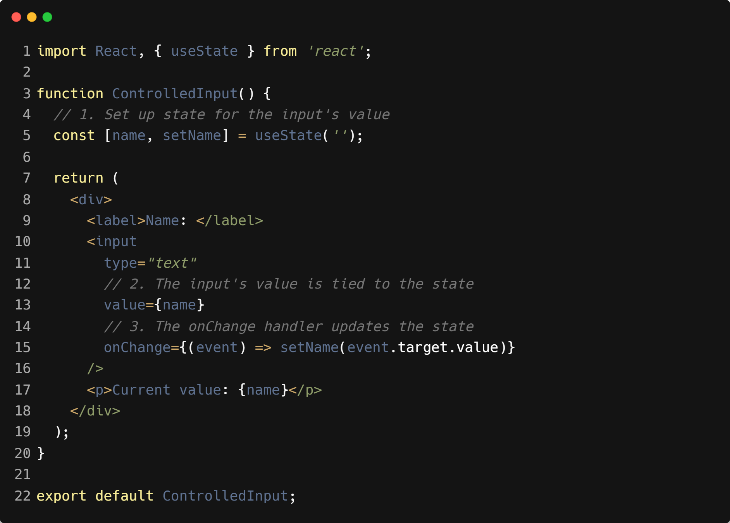
| Coding Questions
Solution :

Slide 53

| Coding Questions
Output :

Slide 54
| Coding Questions
2. Basic Form Submission
Task :
Create a simple login form with an email input and a submit button.
The input should be a controlled component.
When the form is submitted, prevent the default page reload.
Show an alert with the message "Logged in as [email]", where [email] is the value from the input field.

Slide 55
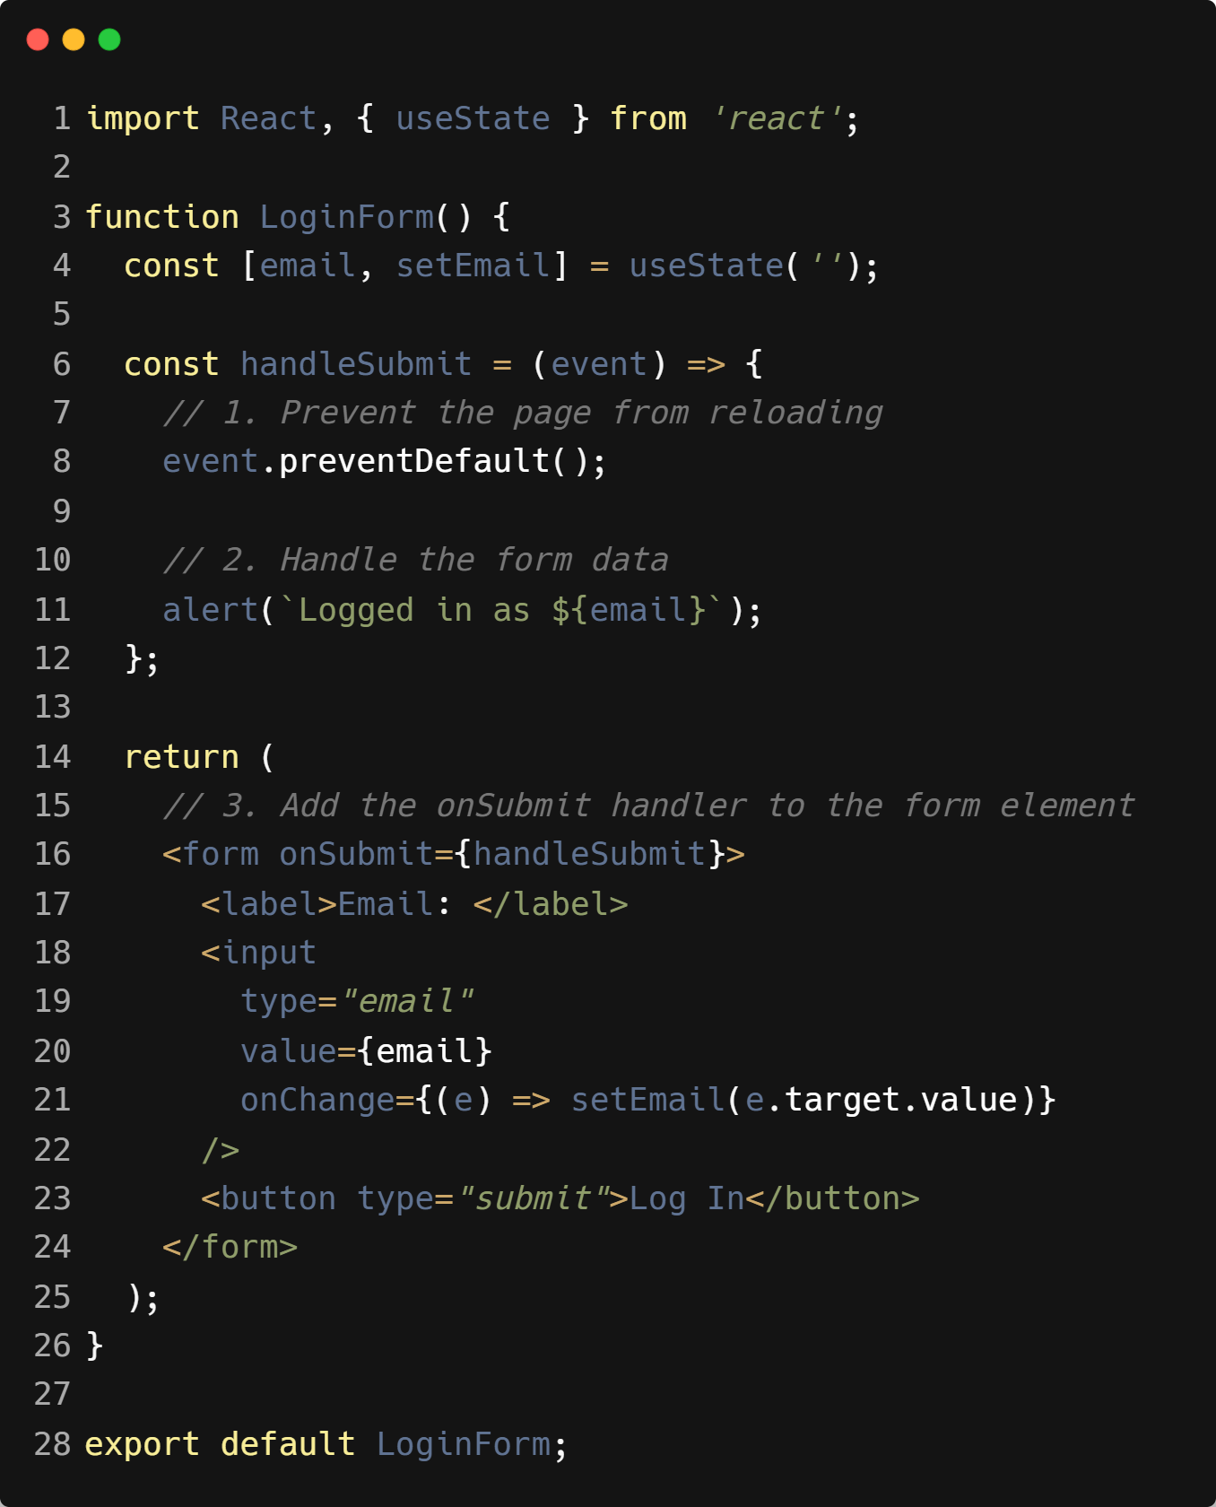
| Coding Questions
Solution :

Slide 56
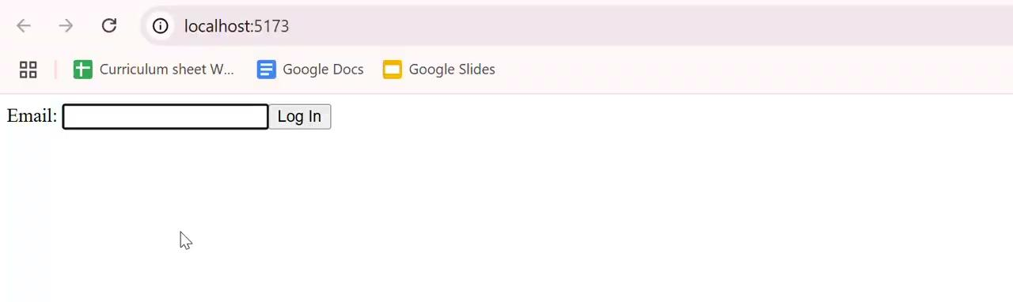
| Coding Questions
Output :

Slide 57
| Coding Questions
1. Basic onClick Handler
Task :
Create a Button component. Inside the component, define a function handleClick that shows an alert with the message "Button was clicked!". Attach this function to the onClick event of a <button> element.

Slide 58
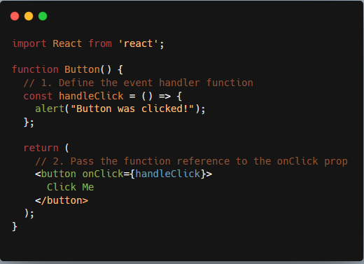
| Coding Questions
Solution :

Slide 59
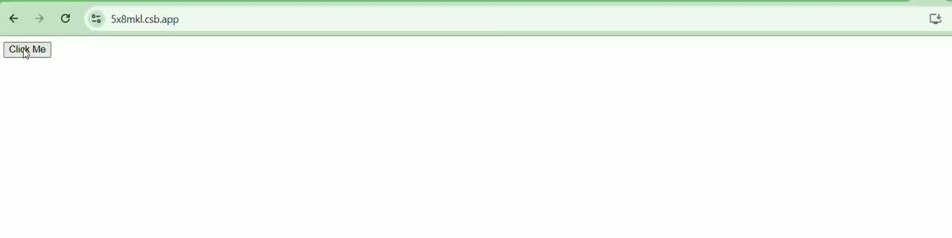
| Coding Questions
Output :

Slide 60
| Coding Questions
2. Passing an Argument to an Event Handler
Task :
Create a Product component that receives a name prop. The component should render the product name and a "Buy" button. When the "Buy" button is clicked, an alert should pop up saying "You bought a [product name]!", using the name passed in via props.

Slide 61
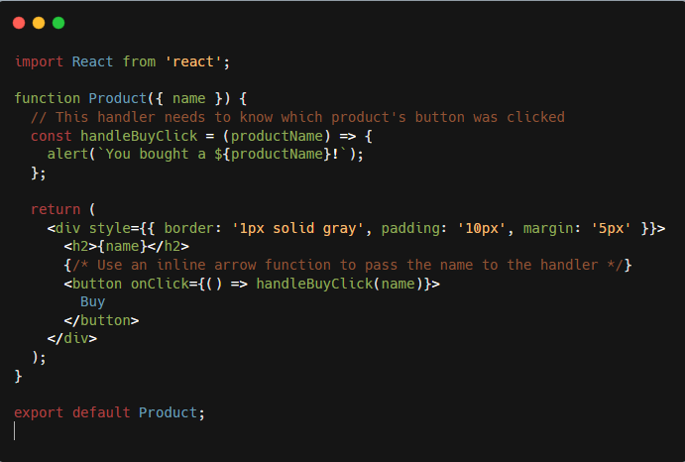
| Coding Questions
Solution:

Slide 62
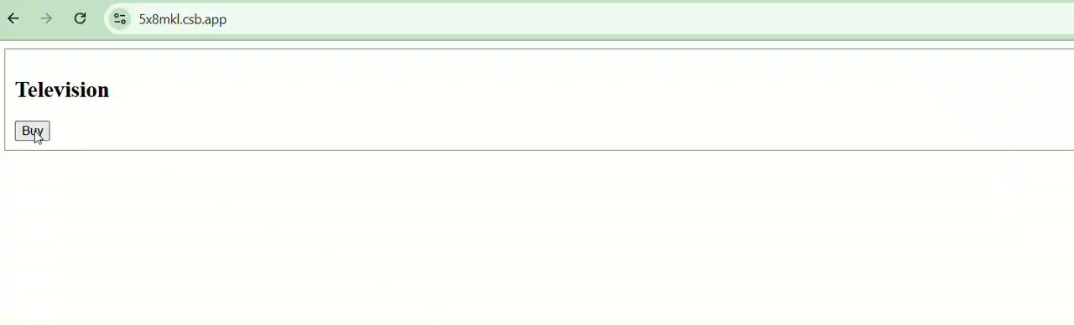
| Coding Questions
Output:

Slide 63
| Check Your Understanding
Question : What is a "controlled component" in React?
Options : a) A component that cannot be changed by the user.
b) An input form element whose value is controlled by React state.
c) A component that can only be used once in an application.
d) An input form element that manages its own state internally in the DOM.
Answer : b) An input form element whose value is controlled by React state.
Explanation:
In a controlled component, React's state is the "single source of truth." The input's value is driven by a state variable, and changes are handled by a function that updates that state.

Slide 64
| Check Your Understanding
Question : Which event handler is typically used on a form input to update its state as the
user types?
Options : a) onClick
b) onSubmit
c) onChange
d) onHover
Answer : c) onChange
Explanation:
The onChange event fires every time the value of the input element changes, allowing you to capture user input in real-time and update the component's state.

Slide 65
| Check Your Understanding
Question : In a controlled input, which two props are essential for connecting it to the React
state?
Options : a) name and id
b) value and onChange
c) type and placeholder
d) state and setState
Answer : b) value and onChange
Explanation:
The value prop sets the input's current display value from the React state, and the onChange prop provides the function to update that state when the user types.

Slide 66
| Check Your Understanding
Question : Why must you call event.preventDefault() in a form's onSubmit handler?
Options : a) To validate the form's data.
b) To prevent the browser's default behavior of reloading the page when a form is submitted.
c) To clear the input fields after submission.
d) To send the form data to a server
Answer : b) To prevent the browser's default behavior of reloading the page when
a form is submitted.
Explanation:
By default, submitting an HTML form triggers a full-page navigation. event.preventDefault() stops this, allowing you to handle the form data within your React application using JavaScript.

Slide 67
| Check Your Understanding
Question : How are event handlers named in JSX?
Options : a) Using lowercase, like onclick.
b) Using uppercase, like ONCLICK.
c) Using camelCase, like onClick.
d) Using kebab-case, like on-click.
Answer : c) Using camelCase, like onClick.
Explanation:
IReact normalizes event names to a camelCase convention (e.g., onmouseover becomes onMouseOver, onclick becomes onClick).

Slide 68
| Check Your Understanding
Question : What is a Synthetic Event in React?
Options : a) An event that is created by a user manually.
b) A cross-browser wrapper around the browser's native event object.
c) An event that only works in class components.
d) A performance--blocking event.
Answer : b) A cross-browser wrapper around the browser's native event object.
Explanation:
React uses Synthetic Events to smooth out differences in event handling across various browsers, providing a consistent API for developers.

Slide 69
| Check Your Understanding
Question : Which is the correct way to pass a reference to a function handleClick to a button's onClick handler?
Options : a) <button onClick={handleClick()}>Click Me</button>
b) <button onClick="handleClick">Click Me</button>
c) <button onClick={handleClick}>Click Me</button>
d) <button onClick={new handleClick()}>Click Me</button>
Answer : c) <button onClick={handleClick}>Click Me</button>
Explanation:
You must pass the function reference itself, not the result of calling the function. handleClick() would execute the function immediately on render, not when the button is clicked.

Slide 70
| Check Your Understanding
Question : How do you pass an argument, like an id, to an event handler function handleItemClick in JSX?
Options : a) <button onClick={handleItemClick(id)}>Click</button>
b) <button onClick={() => handleItemClick(id)}>Click</button>
c) <button onClick={handleItemClick} id={id}>Click</button>
d) <button onClick={handleItemClick.id(id)}>Click</button>
Answer : b) <button onClick={() => handleItemClick(id)}>Click</button>
Explanation:
The most common way is to use an inline arrow function. This creates a new function that, when called by the onClick event, will then execute your handler with the specified argument.

Slide 71
| Check Your Understanding
Question : Why is event binding necessary in class components (when not using arrow functions for methods)?
Options : a) To improve performance.
b) To ensure that this keyword inside the event handler method correctly refers to the component instance.
c) To pass props to the event handler.
d) It is not necessary; it is an optional practice.
Answer : b) To ensure that this keyword inside the event handler method correctly refers to the component instance.
Explanation:
In JavaScript classes, methods are not bound to the instance by default. When passed as an event handler, the this context is lost. Binding in the constructor (or using a class field arrow function) solves this.

Slide 72
| References
MDN Web Docs : Comprehensive and official documentation for JS. 🔗https://developer.mozilla.org/en-US/docs/Web/JavaScript
W3Schools – JS Tutorial : Beginner-friendly JS tutorials with examples and interactive editors. 🔗 https://www.w3schools.com/js/
react.dev - A comprehensive, tutorial-style website that deeply explores core React concepts, including components, state, effects, and hooks, through interactive examples and in-depth explanations.
🔗https://react.dev/

Slide 73
Thanks
For
Watching
Course - Web Development - II
welcome@krmangalam.edu.in
Sohna Road,Gurugram,Haryana 122103

